Slide 1
Introduction
Ministry of Health and family welfare is focusing on various issues where disease prevention is one of the field focus by MISSION INDRADHANUSH . It focuses on vaccination of children and full immunize children of India by 2020.
The Goal of Android APP is to accelerate the mission with the help of technology.
The APP can be used by
Parents
They can schedule the vaccination
Maintain report
Track nearby Hospitals
Government- Provides data of
Percentage of immunized children can be generated

Slide 2
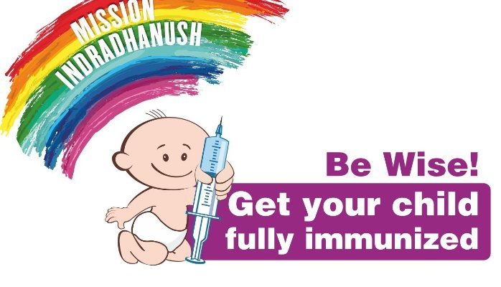
MISSION INDRADHANUSH
MISSION INDRADHAUNSH is focusing to prevent the diseases at early stage by providing vaccination at every part of India.
Objective of mission is to fully immunize all the children of INDIA by 2020.
Accomplishment of this mission will lead to Healthy and Progressive India.

Slide 3
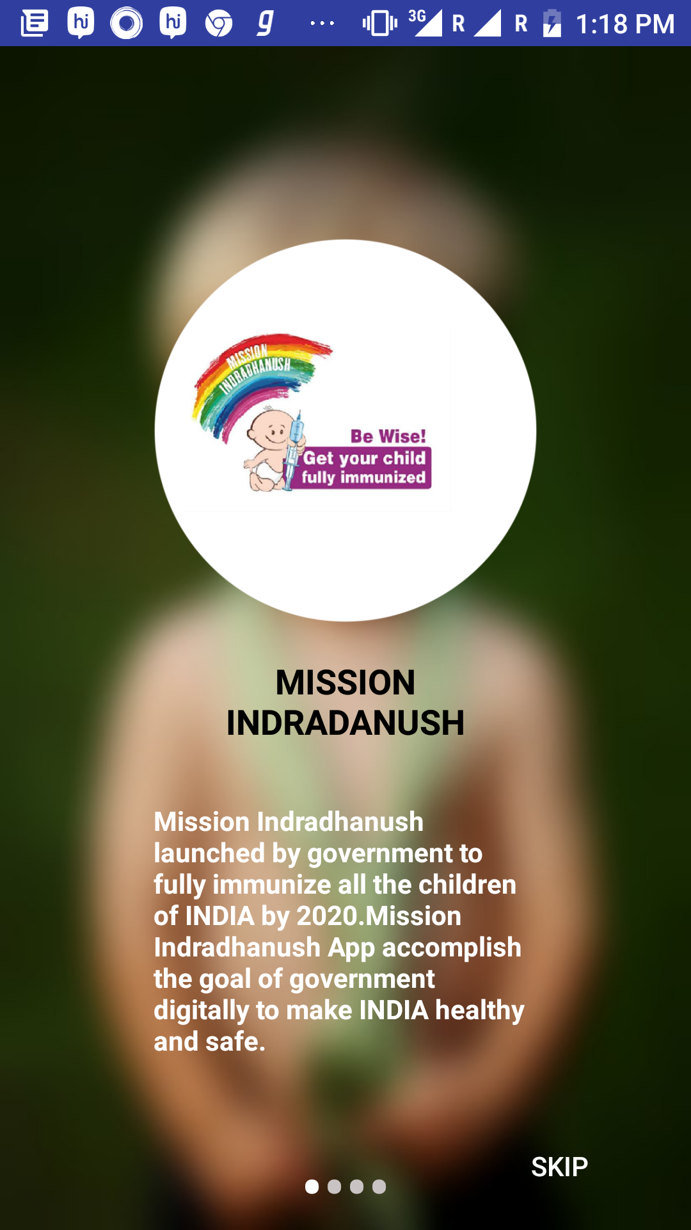
Mamta App
In the digital world era, mobile connect everyone and avail the resources.
Mamta App accomplish the goal of fully immunizing children of age up to 2 years by
Scheduling the vaccination,
generating report regarding the vaccination,
searching nearby hospitals by parents to make INDIA healthy and safe.

Slide 4
VISIONS OF OUR APP
Implementation of Immunization of Children in unapproachable areas.
Providing Organised Data to the Government.
Localization- Providing Application in Local Languages of India

Slide 5
Modules
Parent and child profile
Nearby Hospitals
Report
Vaccination details

Slide 6
Impact
Generated reports will help the government to accomplish their future goals.
It helps to use the government resources in an optimized way.
ACCOUNTABILITY

Slide 7
Integration with government data
Pulling master data from government Database into our APP for better user experience.
To deliver APP Installation SMS to the parent.
Notification of Drives to the nearby users.
Sharing our app data-
% of immunized children can be generated
Male/female ratio report.
% of vaccination details can be generated
Infant-mortality rate can also be calculated.

Slide 8
FUTURE SCOPE
ANALYSIS: APP data can be used for collecting statistics for areas need attention like
To detect the areas need to be focused for vaccination.
To Detect the need of health care centres in nearby places if people ae visiting other places for health care services.
Pregnancy vaccinations: App can be enhanced to provide vaccination for pregnant women.
Filtration of Health care centres according to treatment required.

